Slide 1
Chapter 2: Network Protocols and Communications
Introduction to Networks

Slide 2
Chapter 2: Objectives
After completing this chapter, you will be able to:
Explain how rules are used to facilitate communication.
Explain the role of protocols and standards organizations in facilitating interoperability in network communications.
Explain how devices on a LAN access resources in a small to medium-sized business network.
Notes:
2

Slide 3
Chapter 2
2.1 Rules of Communication
2.2 Network Protocols and Standards
2.3 Moving Data in the Network
2.4 Summary

Slide 4
2.1 Rules of Communication

Slide 5
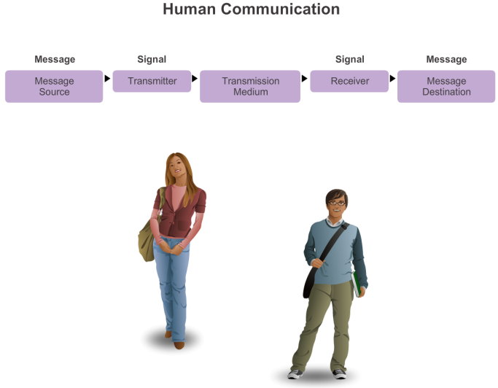
The Rules What is Communication?
Notes:
3.1.1.1 What is Communication?

Slide 6
The Rules Establishing the Rules
An identified sender and receiver
Agreed upon method of communicating (face-to-face, telephone, letter, photograph)
Common language and grammar
Speed and timing of delivery
Confirmation or acknowledgment requirements
Notes:
3.1.1.2 Establishing the Rules

Slide 7
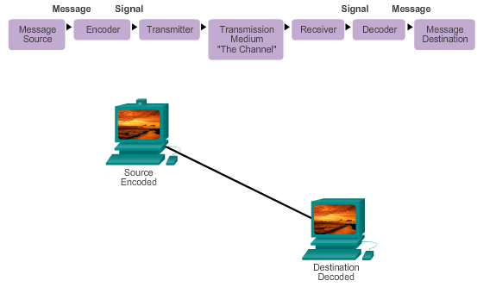
The Rules Message Encoding
Notes:
3.1.1.3 Message Encoding

Slide 8
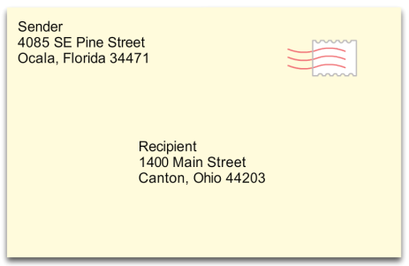
The Rules Message Formatting and Encapsulation
Example: Personal letter contains the following elements:
Identifier of the recipient’s location
Identifier of the sender’s location
Salutation or greeting
Recipient identifier
The message content
Source identifier
End of message indicator
Notes:
3.1.1.4 Message Formatting and Encapsulation

Slide 9
The Rules Message Size
An overview of the segmenting process:
The size restrictions of frames require the source host to break a long message into individual pieces (or segments) that meet both the minimum and maximum size requirements.
Each segment is encapsulated in a separate frame with the address information, and is sent over the network.
At the receiving host, the messages are de-encapsulated and put back together to be processed and interpreted.
Notes:
3.1.1.5 Message Size

Slide 10
The Rules Message Timing
Access Method
Flow Control
Response Timeout

Slide 11
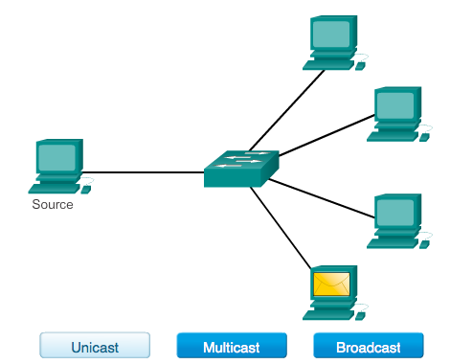
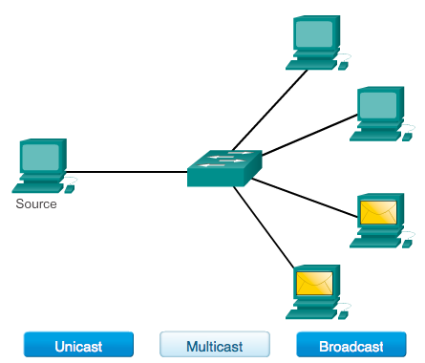
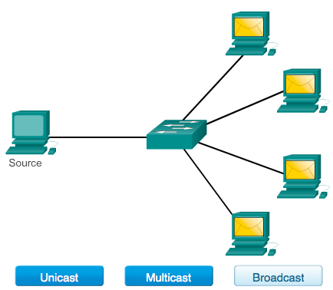
The Rules Message Delivery Options
Notes:
3.1.1.7 Message Delivery Options

Slide 12
2.2 Network Protocols and Standards

Slide 13
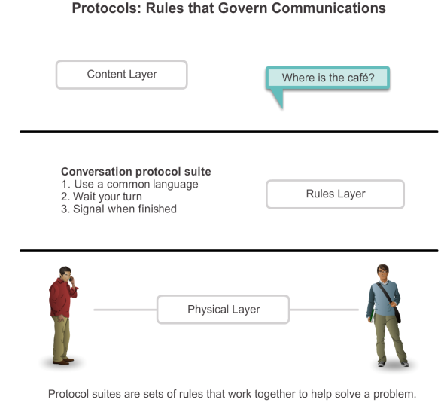
Protocols Rules that Govern Communications

Slide 14
Protocols Network Protocols
How the message is formatted or structured
The process by which networking devices share information about pathways with other networks
How and when error and system messages are passed between devices
The setup and termination of data transfer sessions

Slide 15
Protocols Interaction of Protocols
Application Protocol – Hypertext Transfer Protocol (HTTP)
Transport Protocol – Transmission Control Protocol (TCP)
Internet Protocol – Internet Protocol (IP)
Network Access Protocols – Data link & physical layers

Slide 16
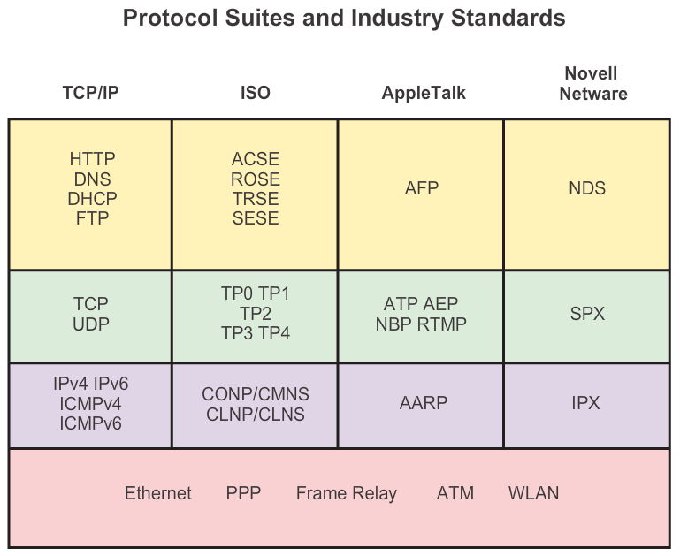
Protocol Suites Protocol Suites and Industry Standards

Slide 17
Protocol Suites Creation of Internet, Development of TCP/IP
The first packet switching network and predecessor to today’s Internet was the Advanced Research Projects Agency Network (ARPANET), which came to life in 1969 by connecting mainframe computers at four locations.
ARPANET was funded by the U.S. Department of Defense for use by universities and research laboratories. Bolt, Beranek and Newman (BBN) was the contractor that did much of the initial development of the ARPANET, including creating the first router known as an Interface Message Processor (IMP).
In 1973, Robert Kahn and Vinton Cerf began work on TCP to develop the next generation of the ARPANET. TCP was designed to replace ARPANET’s current Network Control Program (NCP).
In 1978, TCP was divided into two protocols: TCP and IP. Later, other protocols were added to the TCP/IP suite of protocols including Telnet, FTP, DNS, and many others.

Slide 18
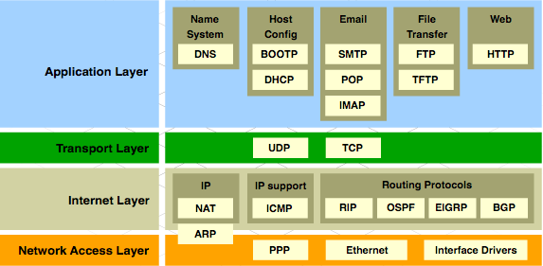
Protocol Suites TCP/IP Protocol Suite and Communication

Slide 19







Standards Organizations Open Standards
The Internet Society (ISOC)
The Internet Architecture Board (IAB)
The Internet Engineering Task Force (IETF)
Institute of Electrical and Electronics Engineers (IEEE)
The International Organization for Standards (ISO)

Slide 20

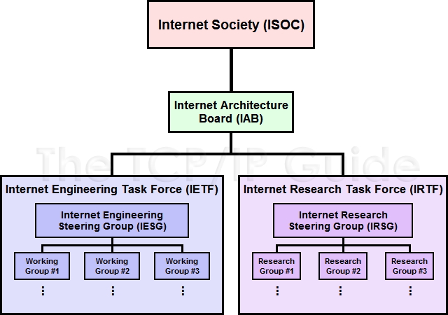



Standards Organizations ISOC, IAB, and IETF

Slide 21
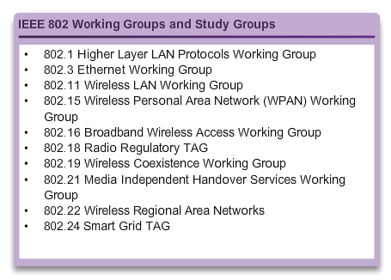
Standards Organizations IEEE
38 societies
130 journals
1,300 conferences each year
1,300 standards and projects
400,000 members
160 countries
IEEE 802.3
IEEE 802.11

Slide 22

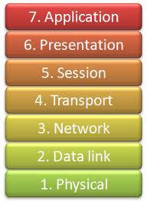
Standards Organizations ISO
OSI Model

Slide 23
Standards Organizations Other Standards Organization
The Electronic Industries Alliance (EIA)
The Telecommunications Industry Association (TIA)
The International Telecommunications Union – Telecommunications Standardization Sector (ITU-T)
The Internet Corporation for Assigned Names and Numbers (ICANN)
The Internet Assigned Numbers Authority (IANA)

Slide 24
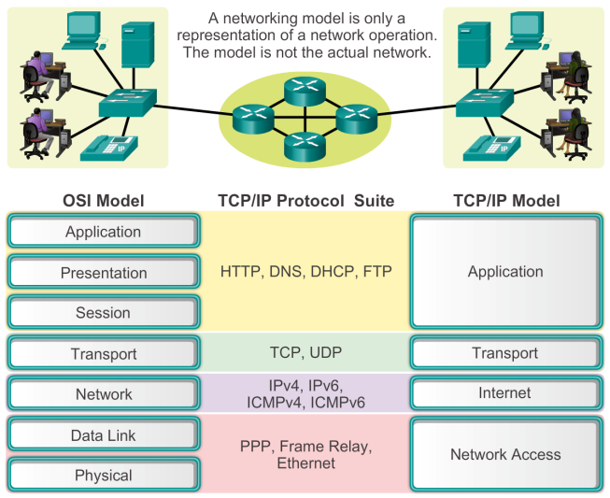
Reference Models Benefits of Using a Layered Model

Slide 25
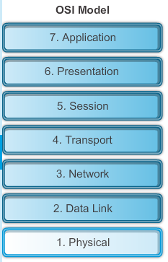
Reference Models The OSI Reference Model
Notes:
3.2.4.2 The OSI Reference Model

Slide 26
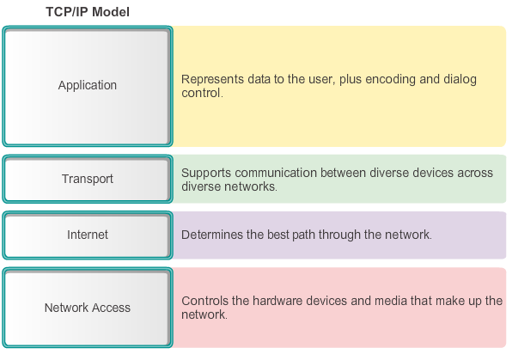
Reference Models The TCP/IP Reference Model
Notes:
3.2.4.3 The TCP/IP Protocol Model

Slide 27
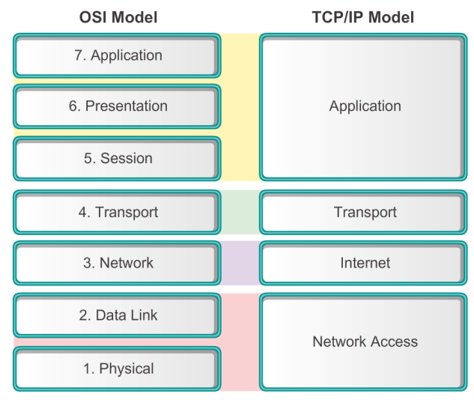
Reference Models Comparing the OSI and TCP/IP Models
Notes:
3.2.4.4 Comparing the OSI Model with the TCP/IP Model

Slide 28
2.3 Moving Data in the Network

Slide 29
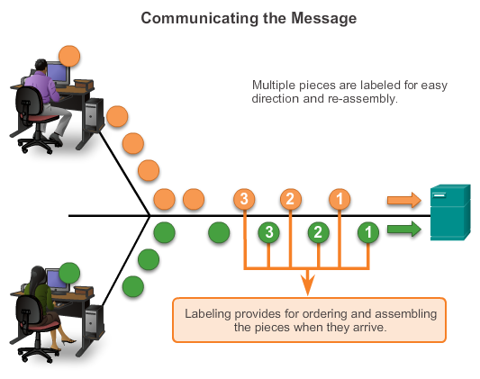
Data Encapsulation Communicating the Messages
Segmenting message benefits
Different conversations can be interleaved
Increased reliability of network communications
Segmenting message disadvantage
Increased level of complexity

Slide 30
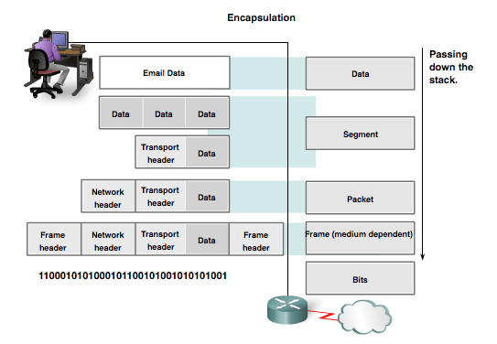
Data Encapsulation Protocol Data Units (PDUs)
Data
Segment
Packet
Frame
Bits

Slide 31
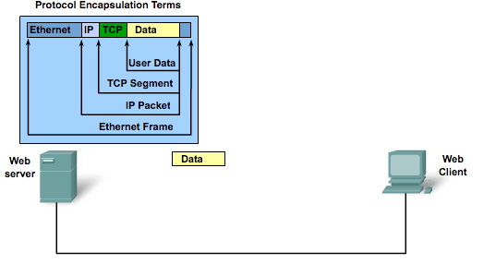
Data Encapsulation Protocol Encapsulation

Slide 32
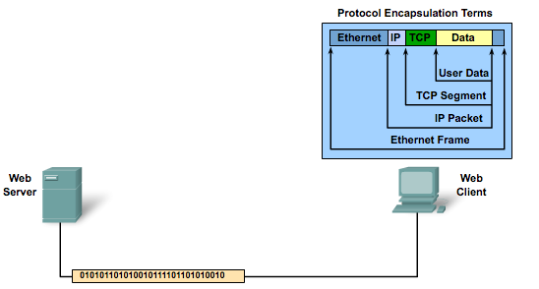
Data Encapsulation Protocol De-encapsulation

Slide 33
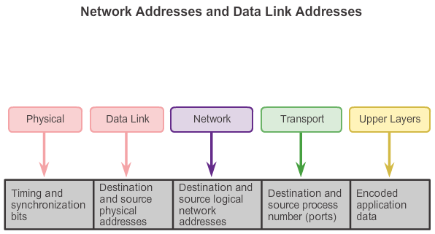
Moving Data in the Network Accessing Local Resources

Slide 34
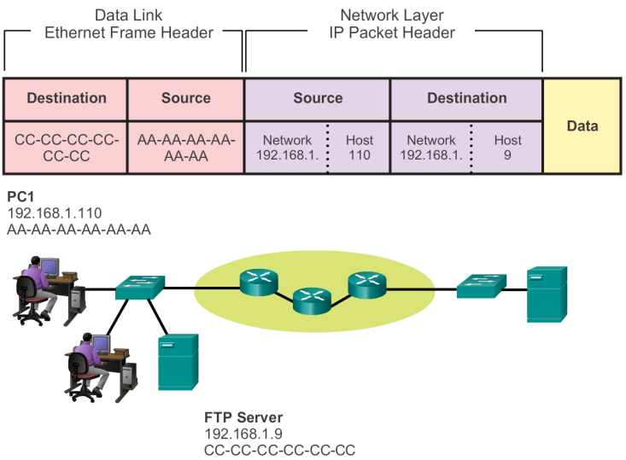

Accessing Local Resources Communicating with Device / Same Network

Slide 35


Accessing Local Resources MAC and IP Addresses
R1
192.168.1.1
11-11-11-11-11-11
ARP
Request
PC1
192.168.1.110
AA-AA-AA-AA-AA-AA
S1
R1
PC2
192.168.1.111
BB-BB-BB-BB-BB-BB
FTP Server
192.168.1.9
CC-CC-CC-CC-CC-CC

Slide 36
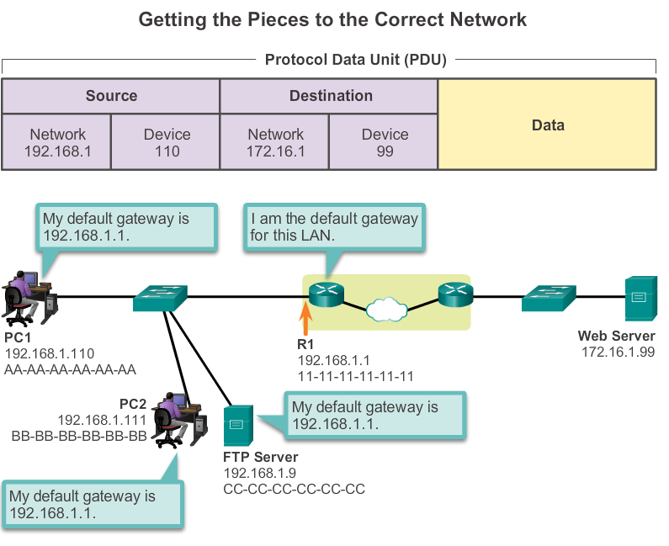
Accessing Remote Resources Default Gateway

Slide 37
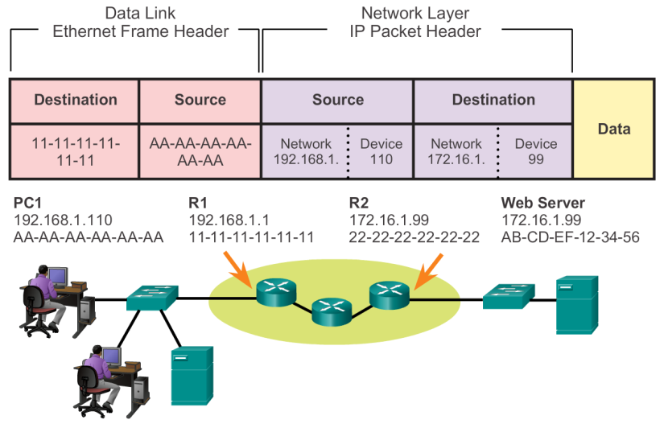
Accessing Remote Resources Communicating Device / Remote Network
Notes:
3.3.3.2 Communicating with a Device on a Remote Network

Slide 38
Network Protocols and Communications Summary
In this chapter, you learned:
Data networks are systems of end devices, intermediary devices, and the media connecting the devices. For communication to occur, these devices must know how to communicate.
These devices must comply with communication rules and protocols. TCP/IP is an example of a protocol suite.
Most protocols are created by a standards organization such as the IETF or IEEE.
The most widely-used networking models are the OSI and TCP/IP models.
Data that passes down the stack of the OSI model is segmented into pieces and encapsulated with addresses and other labels. The process is reversed as the pieces are de-encapsulated and passed up the destination protocol stack.

Slide 39
Network Protocols and Communications Summary (cont.)
In this chapter, you learned:
The OSI model describes the processes of encoding, formatting, segmenting, and encapsulating data for transmission over the network.
The TCP/IP protocol suite is an open standard protocol that has been endorsed by the networking industry and ratified, or approved, by a standards organization.
The Internet Protocol Suite is a suite of protocols required for transmitting and receiving information using the Internet.
Protocol Data Units (PDUs) are named according to the protocols of the TCP/IP suite: data, segment, packet, frame, and bits.
Applying models allows individuals, companies, and trade associations to analyze current networks and plan the networks of the future.

Slide 40


